Slide 1
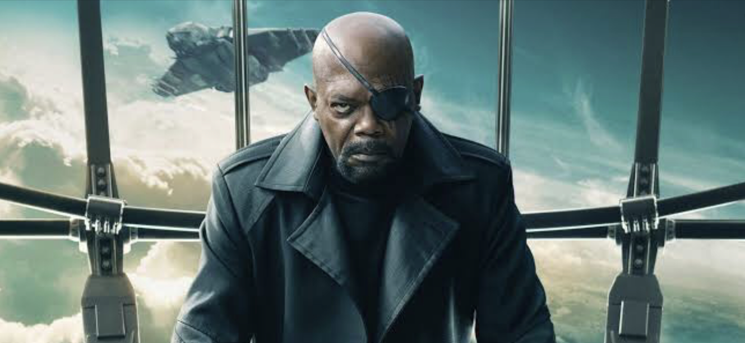
Building a blockbuster
Marketing your next film

Slide 2
If no one sees your next film...
Did you actually make it?

Slide 3
Marketing a film is just as important as making one
Get enough screen time
Make a return on the investment made
Start to build a following
Make enough to finance your next film
Make some money!

Slide 4
When does film marketing begin?
During the conceptual stage
Make your film marketable - story, characters, setting
Casting - believability and star power (social media)
Think about product placement

Slide 5
When does the publicity campaign begin?
Acquisition of story rights
Contracting of director
Contracting of lead cast
Announcement of pre-production
First day of production

Slide 6
Why start so early?
To create anticipation for the film
To warn producers with the same idea
To get the best possible release date
To compensate for a low marketing budget

Slide 7
Take the audience behind the scenes
Let your audience feel like a part of the filmmaking process from early on
This commitment can lead to eventual ticket purchase
Leverage on trivia about the location, production process, actors and crew
Film and photograph everything

Slide 8
The details matter
The movie title
The logo
The tagline
Cast photographs
Graphic design
Poster concept

Slide 9
Make the best possible trailers
Make the trailer tell a story
Script it
Use an expert editor
Add exciting captions and SFX
Use a great voiceover and music
Test it - over and over

Slide 10
Make the best possible poster
Understand genre design
Create different concepts
Resist the ensemble image
Make it consistent with the film and marketing strategy
Make it memorable
Think ahead about multiple media formats

Slide 13
Plan your social media campaign
Find an agency or individual that has a good track record
Create a schedule of frequent posts including those by cast
Build a library of content before it’s needed
Find different ways to engage the audience - BTS, characters, memes, teasers, posters, giveaways...
Don’t overdo it

Slide 14
Produce great in-cinema materials
Standees tend to suggest a big movie
Active moviegoers are your best possible target audience
A great prop for fans’ selfies
Creates top-of-mind awareness
Don’t forget digital posters, countertops and floor stickers

Slide 15
Always have a premiere
It doesn’t have to be huge and costly
It just needs to look great in the media
Don’t overpower your cast with too many celebrities
It’s a media event - treat them well
Don’t obsess over a dress code if it’s not going to sell the movie

Slide 16
Focus on opening weekend / week
This is the most critical time of all
Your whole campaign is leading to this moment
Word-of-mouth (WOM) takes over afterwards
Take advantage of WOM by amplifying it on social media
Get everyone involved

Slide 17
Keep going
Don’t stop pushing until the cinema run ends
Learn from your mistakes
Listen to your distributor
Evaluate feedback
Develop a formula over time

